Slide 1

Stress Management
Brian McKean

Slide 2



https://www.biotrakhealth.com/

Slide 3

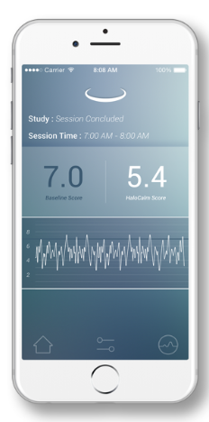
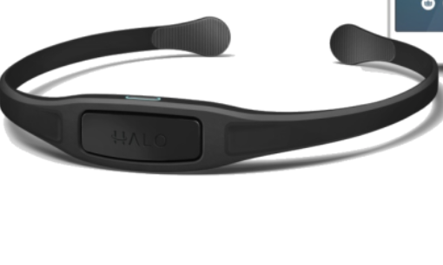






Architecture
BioTrak Health Cloud Backend

Slide 4
Project objectives
Friend and Family Trial Started
Monitor Sessions Done by Trial Users
Develop Automated Classification
Identify Bad Sessions

Slide 5
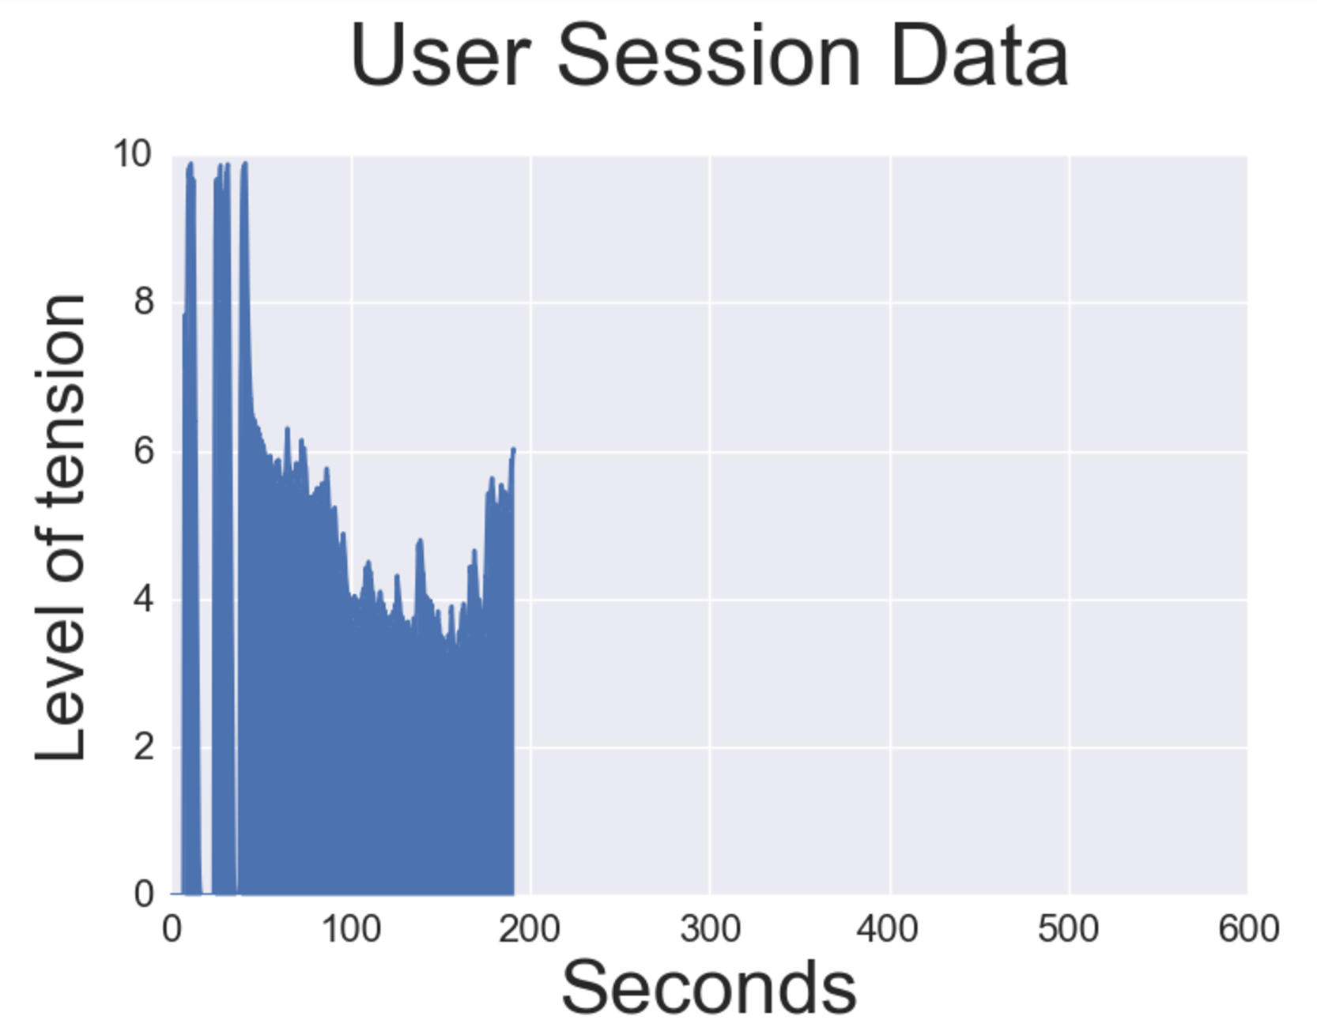
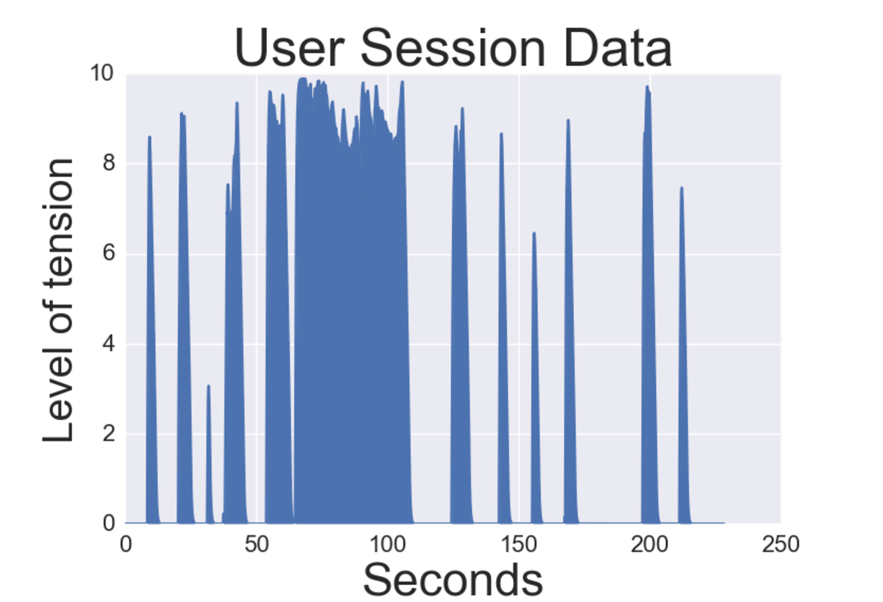
Data
Effective Session
Session with problems

Slide 6
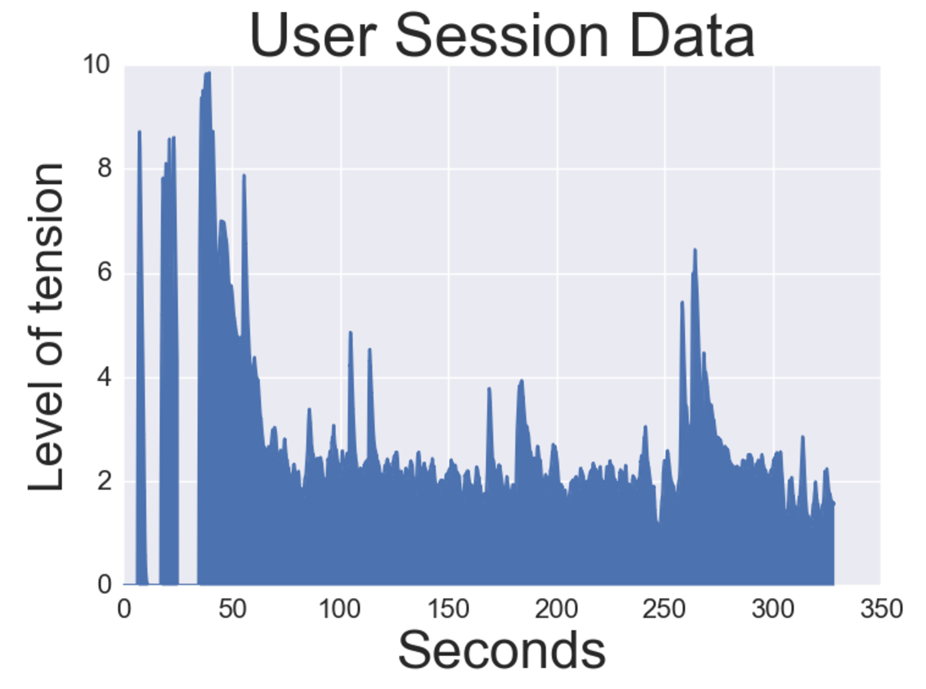
Analysis
356 Sessions
“Good” : 119
“Bad”: 237
Min
Max
Mean
Standard Deviation
Random Forest
Heuristics for good sessions:
At least 60 seconds
No drop to 0 after 60 seconds
No rise to 10 after 60 seconds
Length of time series
Average Frequency
Largest movement

Slide 7
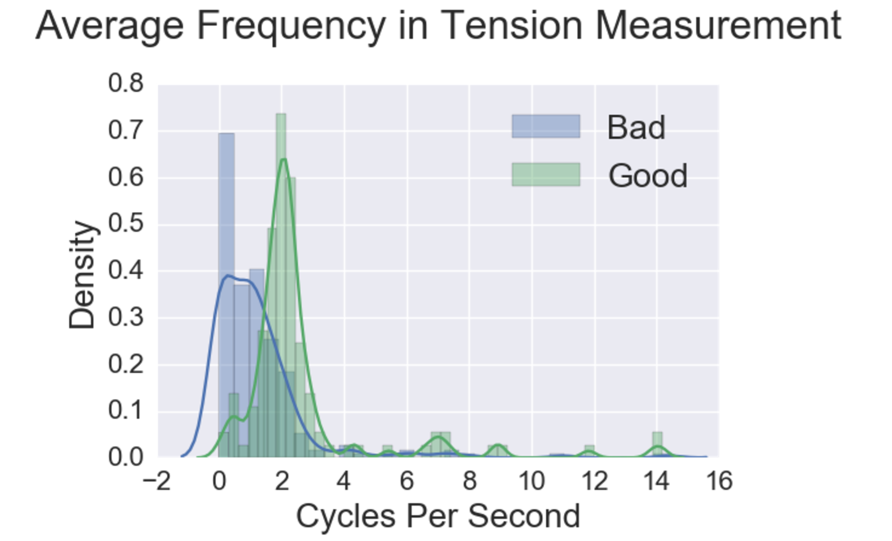
MODEL- Feature Influence

Slide 8
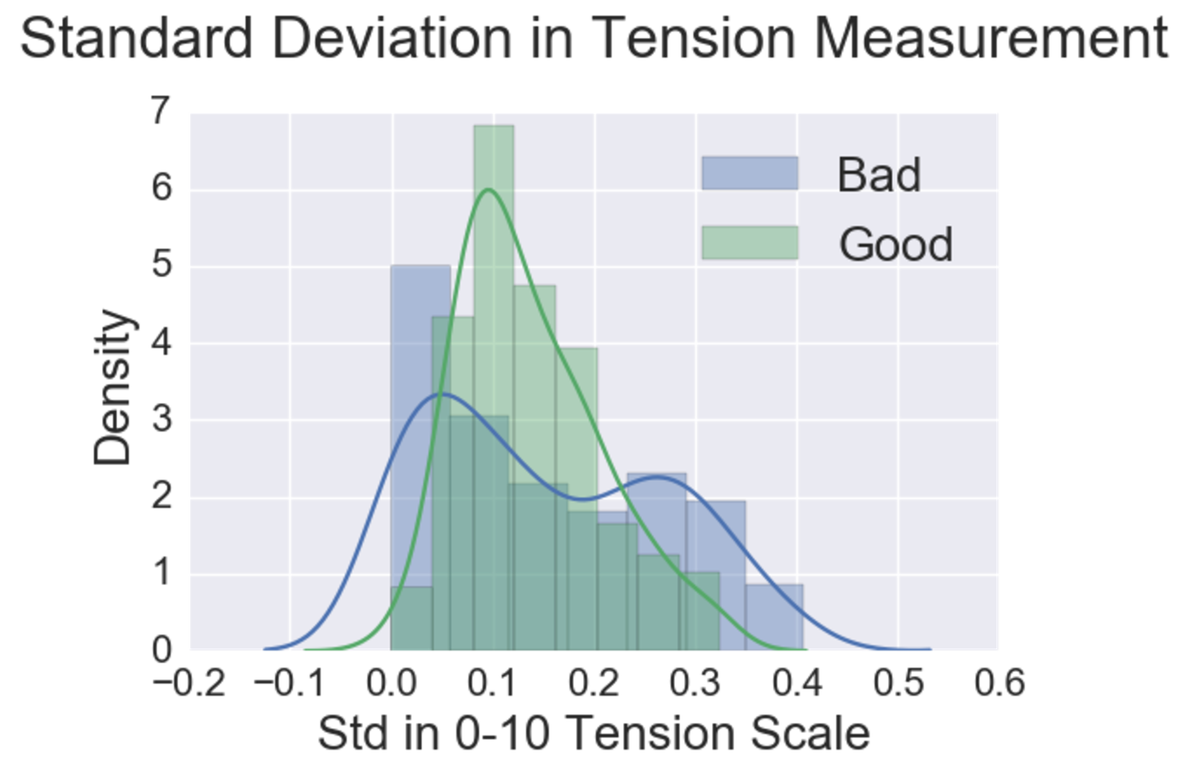
MODEL- Feature Influence

Slide 9



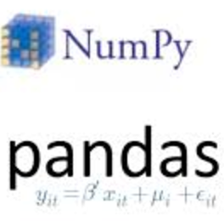

RESULTS - Model Deployment
BioTrak Health Cloud Backend
Data
Science
Stack
Data Science Stack

Slide 10
Questions?
https://github.com/bdmckean/Stress_Management
Brian McKean
bdmckean@gmail.com
Github.com/bdmckean
Linkedin.com/in/brianmckean

